Slide 1
National Level Programmes and Applications in Weather Forecasting Services
Dr.M.Rajavel
Scientist-E
Meteorological Centre, Bengaluru

Slide 2
Ministry of Earth Sciences (MoES)
MoES is mandated to translate Science to Services for the Society in providing services for weather, climate, ocean and coastal state, hydrology, seismology, and natural hazards; to explore and harness marine living and non-living resources in a sustainable manner for the country and to explore the three poles of the Earth (Arctic, Antarctic and Himalayas).
These services include weather forecasts (both on land and in the Oceans) and warnings for various natural disasters like tropical cyclones, storm surge, floods, heat waves, thunderstorm and lightning; alerts for Tsunamis and monitoring of earthquakes, etc. The services provided by the Ministry are being effectively used by different agencies and state governments for saving human lives and minimising damages to the properties due to natural disasters.
R & D and operational (services) activities of MoES are carried out by ten Institutes of MoES
1. India Meteorological Department (IMD),
2. National Centre for Medium Range Weather Forecasting (NCMRWF),
3.Centre for Marine Living Resources and Ecology (CMLRE),
4.National Centre for Coastal Research (NCCR),
5. National Centre for Seismology (NCS),
6. National Institute of Ocean Technology (NIOT),
7. Indian National Centre for Ocean Information Service (INCOIS),
8. National Centre for Polar and Ocean Research (NCPOR), Goa,
9. Indian Institute of Tropical Meteorology (IITM), Pune
10. National Centre for Earth Science Studies (NCESS).
A fleet of oceanographic and coastal research vessels of the Ministry provide required research support for scheme.
Earth System Sciences deal with all the five components of the earth system: atmosphere, hydrosphere, geosphere, cryosphere, and biosphere and their complex interactions. The Ministry of Earth Sciences (MoES) holistically addresses all the aspects relating to the Earth System Science. The overarching scheme of PRITHVI will holistically address all the five components of earth system to improve the understating of the Earth System Sciences and to provide reliable services for the country. Various components of PRITHVI scheme are inter-dependent and are carried out in an integrated manner through combined efforts of the concerned Institutes under MoES. The overarching scheme of Prithvi Vigyan will enable development of integrated multi-disciplinary earth science research and innovative programs across different MoES institutes. These integrated R&D efforts will help in addressing the grand challenges of weather and climate, ocean, cryosphere, seismological science and services and explore the living and non-living resources for their sustainable harnessing.

Slide 3
Overarching scheme “PRITHvi VIgyan (PRITHVI)” of the Ministry of Earth Sciences
The Union Cabinet Chaired by the Prime Minister, Shri Narendra Modi has approved the overarching scheme “PRITHvi VIgyan (PRITHVI)” of Ministry of Earth Sciences, for implementation during the period from 2021-26 at an overall cost of Rs. 4,797 crore.
The scheme encompasses five ongoing sub-schemes namely
“Atmosphere & Climate Research-Modelling Observing Systems & Services (ACROSS)”,
“Ocean Services, Modelling Application, Resources and Technology (O-SMART)”,
“Polar Science and Cryosphere Research (PACER)”,
“Seismology and Geosciences (SAGE)” and
“Research, Education, Training and Outreach (REACHOUT)”.

Slide 4
Major Objectives of the overarching Prithvi Scheme
Augmentation and sustainance of long-term observations of the atmosphere, ocean, geosphere, cryosphere and solid earth to record the vital signs of the Earth System and change
Development of modelling systems for understanding and predicting weather, ocean and climate hazards and understanding the science of climate change
Exploration polar and high seas regions of the Earth towards discovery of new phenomena and resources;
Development of technology for exploration and sustainable harnessing of oceanic resources for societal applications
Translation of knowledge and insights from Earth systems science into services for societal, environmental and economic benefit.

Slide 5
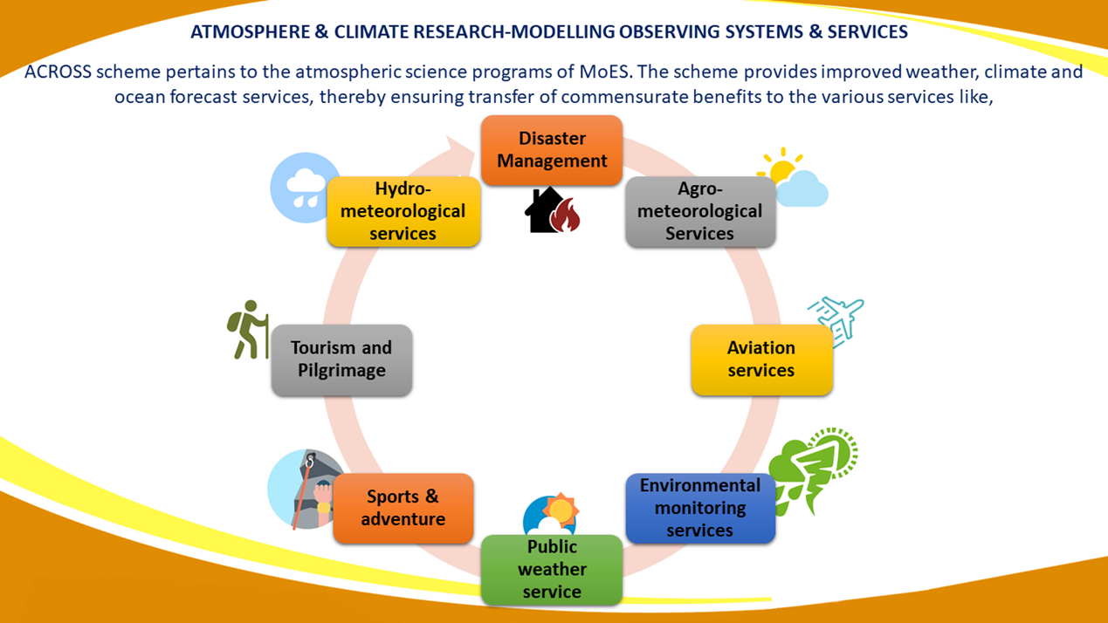
Atmosphere & Climate Research-Modelling Observing Systems & Services (ACROSS)
The entire gamut of weather/climate prediction involves the observational systems, assimilation of meteorological observations, understanding the processes, research and development of dynamical models and providing the forecast services.
ACROSS is implemented by four different institutions under MoES namely:
India Meteorological Department (IMD),
National Centre for Medium Range Weather Forecasting (NCMRWF),
Indian Institute of Tropical Meteorology (IITM)
and Indian National Centre for Ocean Information Services (INCOIS) which implements a small part of the sub scheme.

Slide 6
Atmospheric, Climate Science and Services
ACROSS is composed of
Monsoon Convection, Clouds, and Climate Change (MC4)
High Performance Computing System (HPCS)
Monsoon Mission (MM-II)
Atmospheric Observations Network
Weather & Climate Services
Upgradation of Forecast System
Commissioning of Polarimetric Doppler Weather Radars (DWRs)

Slide 7
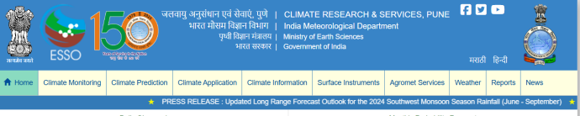
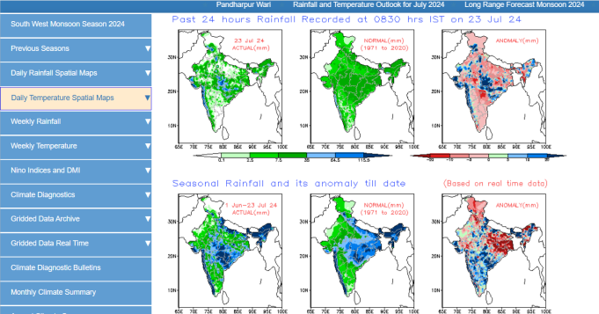
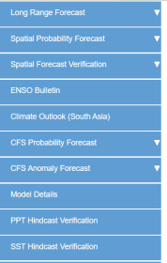
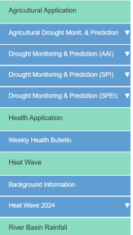
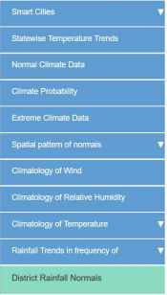
Climate Research & Services
Climate prediction
Climate application
Climate information
Climate monitoring

Slide 8
CLIMATE PREDICTION
Long Range Forecasting (LRF)
To prepare and issue operational extended and long range forecasts for the country.
Grid point rainfall data over the country: Prepares daily grid point rainfall data at two different high resolution spatial grids (1ºX 1º and 0.5ºX 0.5º).
The daily, monthly and seasonal rainfall maps prepared based on these data are available through IMD, Pune website (www.imdpune.gov.in).
IMD has implemented a new strategy for issuing monthly and seasonal operational forecasts for the southwest monsoon rainfall over the country by modifying the existing two stage forecasting strategy.
The new strategy uses both dynamical and statistical forecasting system. Multi-Model Ensemble (MME) forecasting system based on coupled global climate models (CGCMs) from different global climate prediction centres, including IMD’s Monsoon Mission Climate Forecast System (MMCFS) are used in dynamical forecast system.

Slide 9
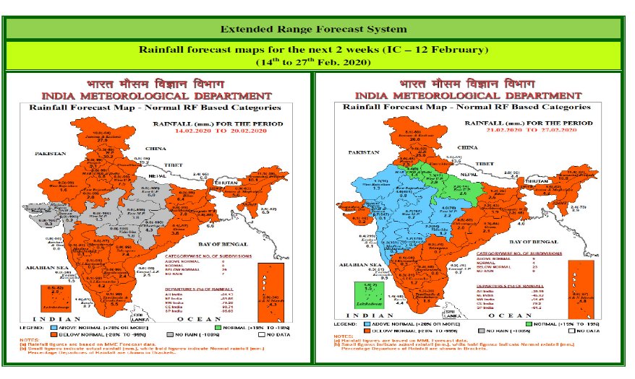
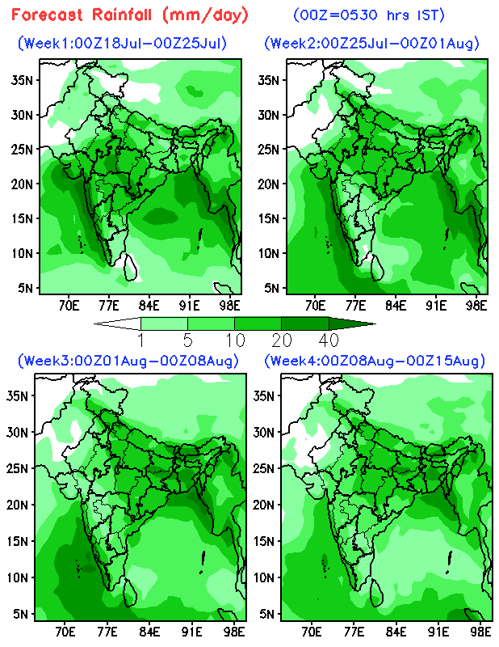
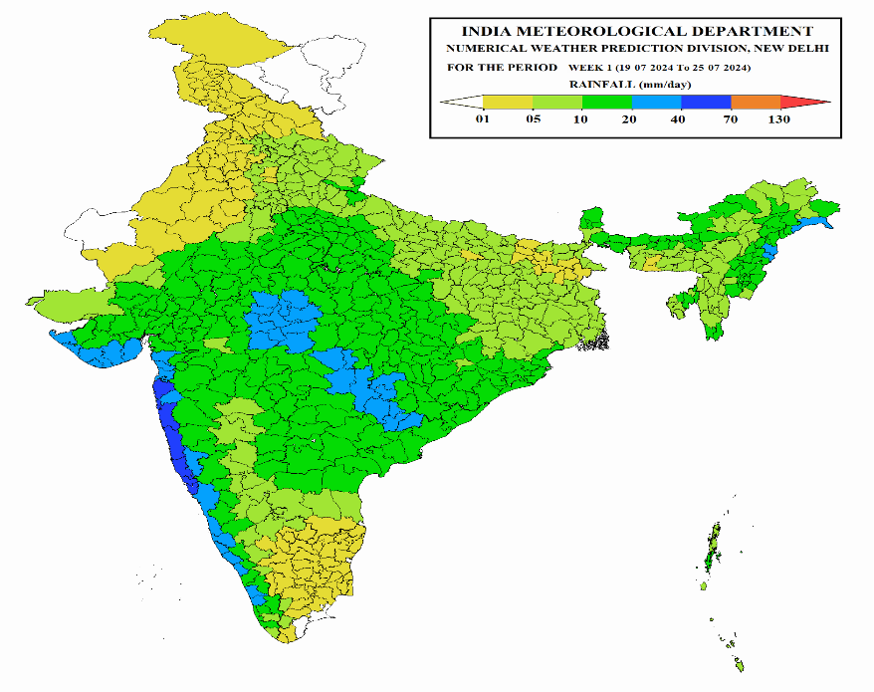
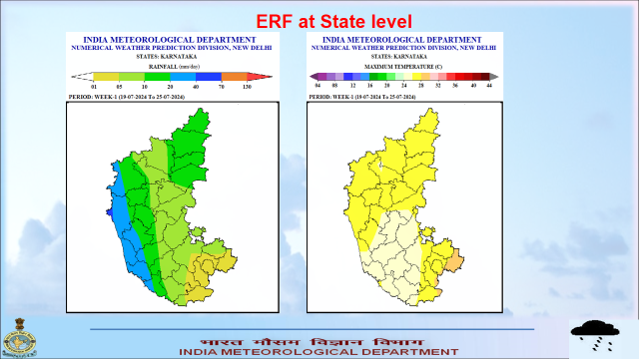
Extended range forecast

Slide 10
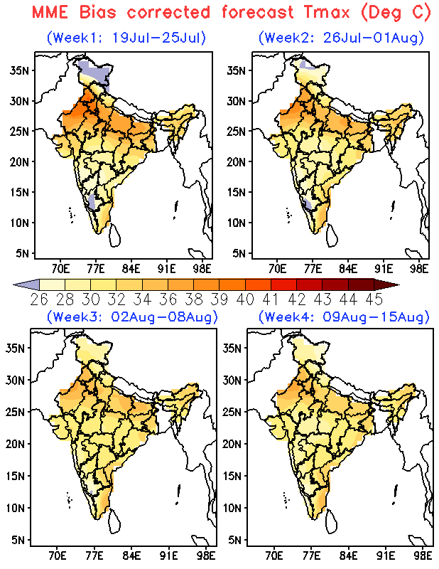
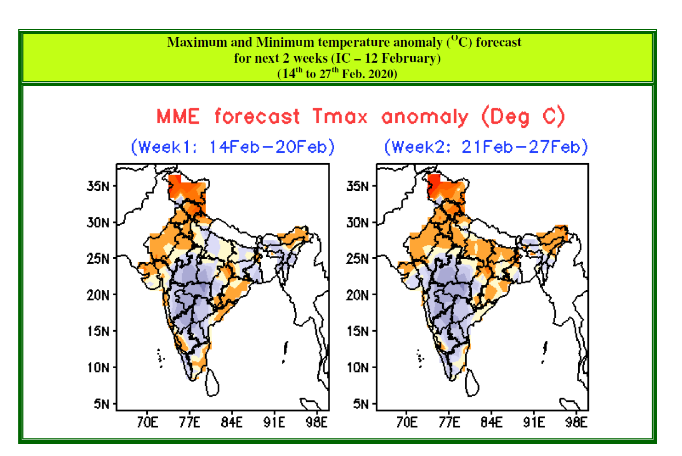
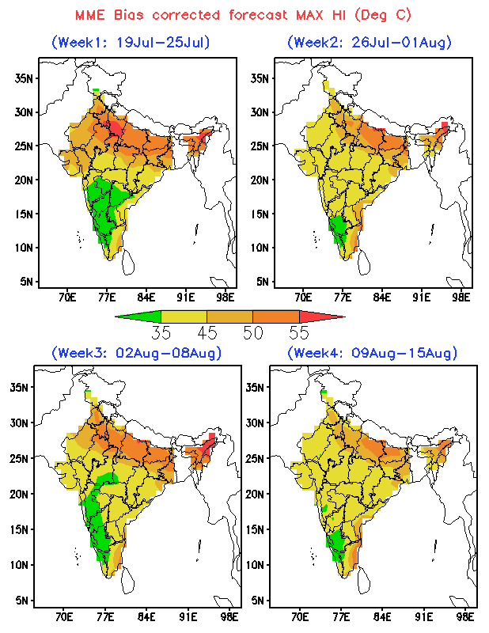
Extended range forecast

Slide 11
Tentative annual time schedule for issuing various operational long range forecast/ outlook
S. No | Forecast to be issued | Tentative time of issue
1 | First Stage Forecast for the Season (June –September) Rainfall over the country as a Whole | Mid April
2 | Date of Monsoon Onset over Kerala | Around 15th May
3 | Second Stage Forecast consisting of update for the first stage forecast, forecast for monthly rainfall over the country as a whole for the months of July & August, and the season rainfall over four geographical regions of the country. | First week of June
4 | Mid Monsoon Review and Outlook for Second half of Season (August-September). | End week of July
5 | Outlook for September Rainfall over the country as a whole. | End week of August
7 | NE Monsoon Season (October to December) rainfall for south Peninsula. | End of September
8 | Winter season (Jan- March) precipitation over north India. | End of December

Slide 12
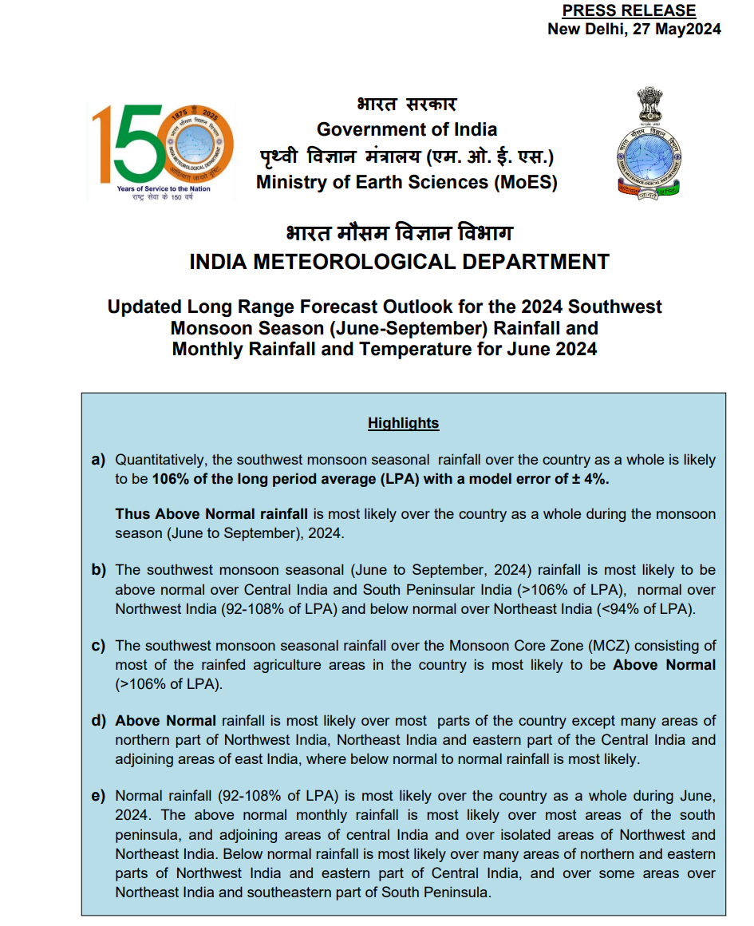
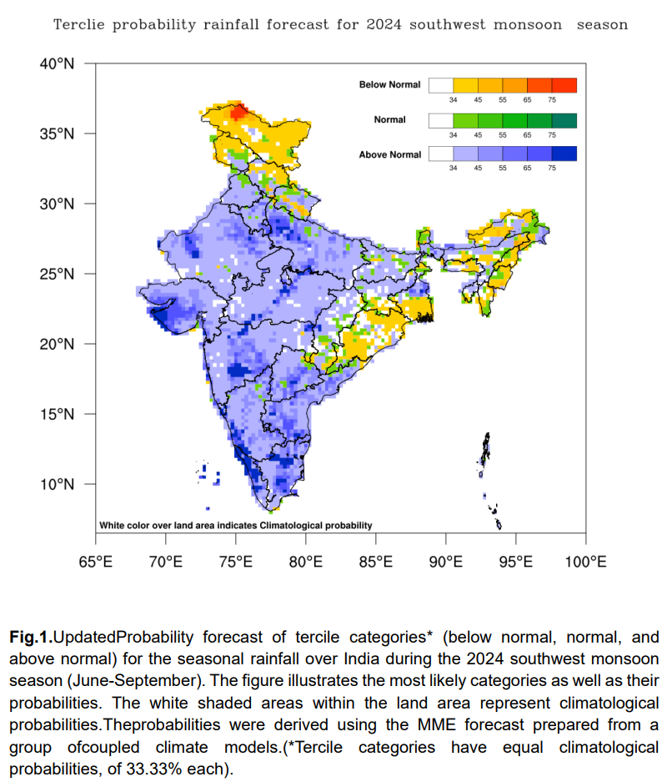
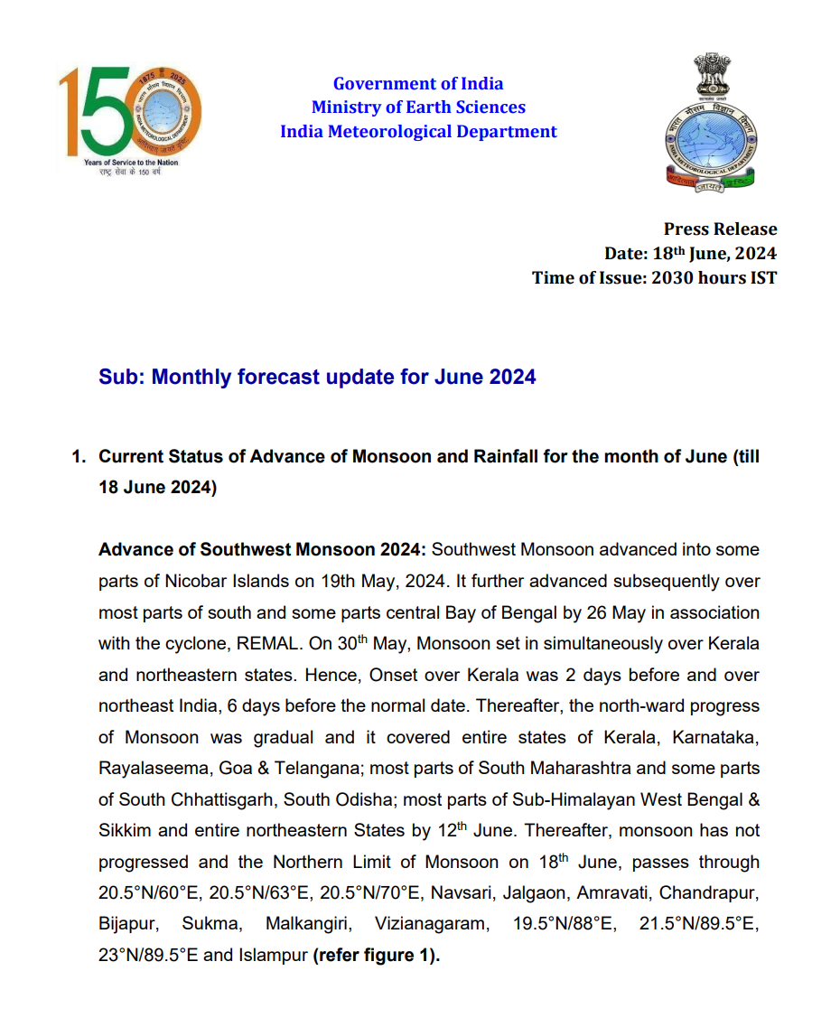
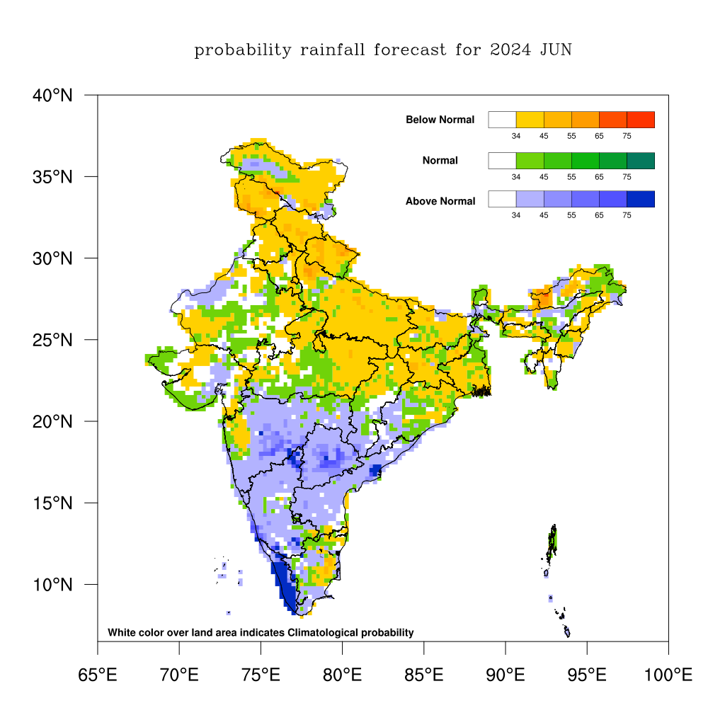
SWM Seasonal/monthly Forecast

Slide 13
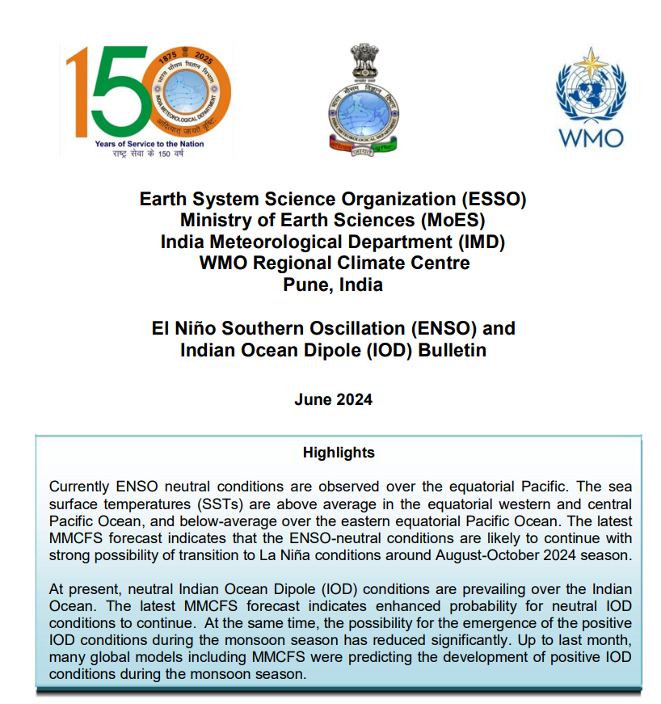
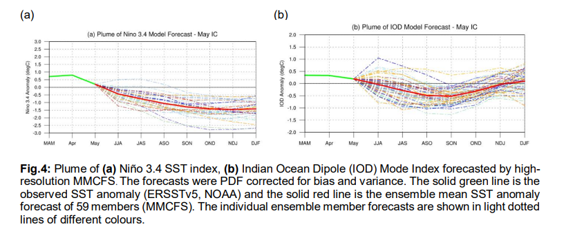
El-Nino Southern Oscillation(ENSO) bulletin

Slide 14
Weather & Climate Services
IMD provides services to weather-sensitive sectors viz. agriculture, irrigation, shipping, aviation, offshore oil explorations, etc.
Over the years, specialized services have also been built for state-of-the-art Monitoring, Detection and Early Warning of extreme weather phenomena including tropical cyclones, severe thunderstorms, dust storms, heavy rains and snowfall events, cold and heat waves, etc.
The meteorological services have significant societal impact. Public/private/government sectors demand for accurate prediction of weather and climate at various temporal and spatial scales is increasing due to possible impacts of global climate variability and change.
The weather services are dependent on the sustained investments in Research and Development (R&D) and capacity building so that advances in weather and climate sciences get inducted in to service through a focused performance evaluation in a semi-operational environment.
Further improvement of current services requires effective conversion of R&D results into fully operational products, services and effective means to develop linkages with decision-makers and users. Especially, effective use of public weather services to communicate through tools, products and services that are useful for decision-making is the need of the hour.

Slide 15
Weather and Climate Services
Major components of “Weather and Climate Services” are:
Gramin Krishi Mausam Sewa (Agrometeorological Advisory Services)
Augmentation of Aviation Meteorological Services
Climate Services
Training in Operational Meteorology
Capacity Building

Slide 16
Weather and Climate Services-Objectives
Develop an Advanced Weather Prediction System for block level forecasts, skilful for next 3-5 days and develop advisories for sectors like Agriculture, Disaster Management, Water resources, Power, Tourism and Pilgrimage, Smart cities, Renewable Energy sector and Transport.
Setting up of District Agro-Met Units (DAMUs) in all the districts of the country for extension of Agromet Advisory Services (AAS).
To expand the outreach of weather based Agromet advisories to the 94 million farmers through multiple means of communication, collection of feedback and impact assessment of AAS.
Develop a state-of-the-Art support system for Aviation safety with the automated Aviation Weather Observing System and advanced forecasting tools for all the civil airports in the country.
Establishing new Aerodrome MET Offices at Greenfield Airports and setting up of automated Heliport Weather Observing & Transmitting System at Heliports, Landing ground and other strategic locations to support the Helicopter and low-level flight operation of Indian Air Force, Indian Army and also at important tourist and pilgrimage locations.
Establish a state-of-the-art Climate Data Centre with integrated advanced climate data services portal for rendering national and regional climate services. The climate data centre will provide a comprehensive set of improved and specialized climate services for the country through upgradation of the existing operational activities of climate monitoring, climate prediction, climate data management and climate application.
Provide appropriate climate services to South Asia as WMO recognized Regional Climate Centre (RCC) for the region.
To upgrade the training infrastructure and facilities to enhance the capacity of the training establishment to bear increased loads of long-term ab-initio training courses for new entrants, career progression courses and short term courses in specialized topics, training to the personnel from countries.
Contributions among WMO, Regional Integrated Multi-Hazard Early Warning System for Africa and Asia (RIMES)/ Economic and Social Commission for Asia and the Pacific (ESCAP)/ Global Framework for Climate
Services (GFCS) in South Asia etc.
Conduct of workshops, Seminars, Trainings, Symposiums, Users meet, Advertising & Publicity, Outreach activities etc

Slide 17
Upgradation of Forecast System
This is a part of the sub-scheme “Atmosphere & Climate Research-Modelling Observing Systems & Services (ACROSS)” of MoES.
Upgradation of Forecast System is aimed at improving the accuracy of weather forecasts to bring it at par with the international standards which will help many sectors like army operations, air operation, agriculture, tourism, mountaineering, aviation, roads and communications, power generation, water management, environmental studies, Sports & Adventure, Transport, Government Authorities, NGOs and Public in general.

Slide 18
Upgradation of Forecast System-Objectives
Upgradation and sustenance of Communication Systems for Data and Product transmission.
Development of an advanced Operational Forecast System, Delivery System for Forecast and other services.
Conduct of special campaign for improving Cyclone, Thunderstorm and Fog forecasting through Aircraft reconnaissance and provision of additional observations.
Integrated Himalayan Meteorological Programme for Western & Central Himalayas.
Capacity Building, Outreach, Planning and sustenance of specific process related observing systems over India.

Slide 19
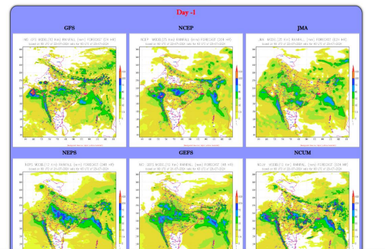
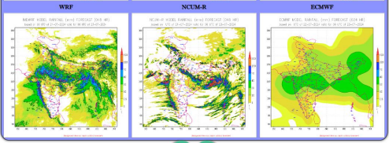
Multi model forecast products

Slide 20
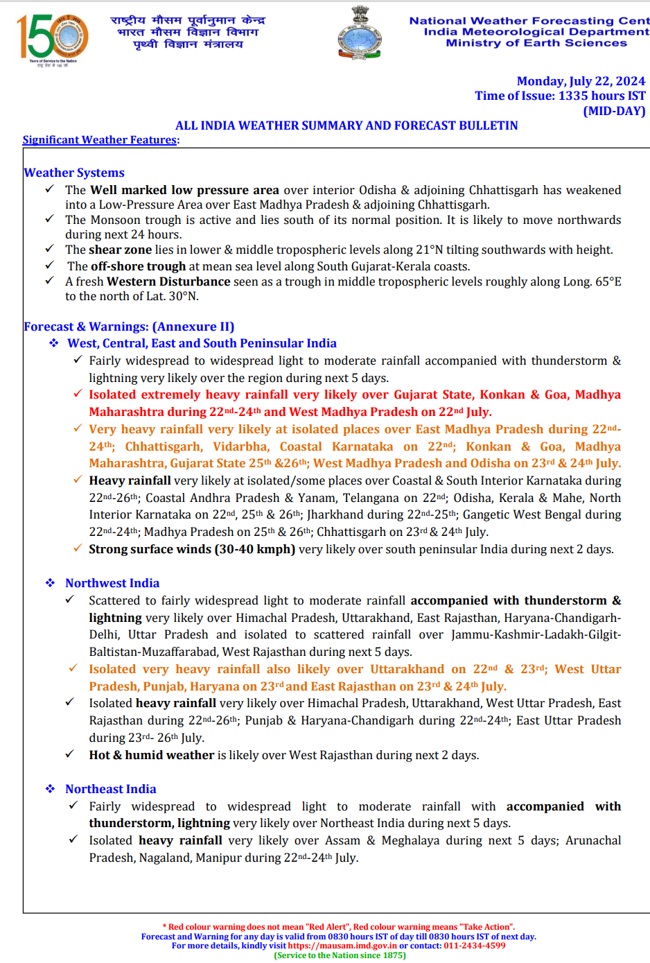
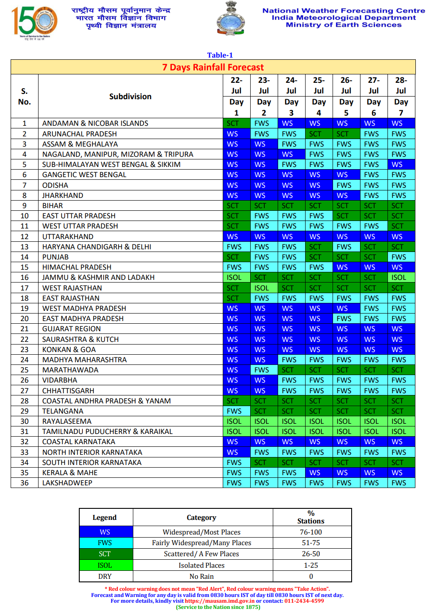
Forecast Bulletins

Slide 21
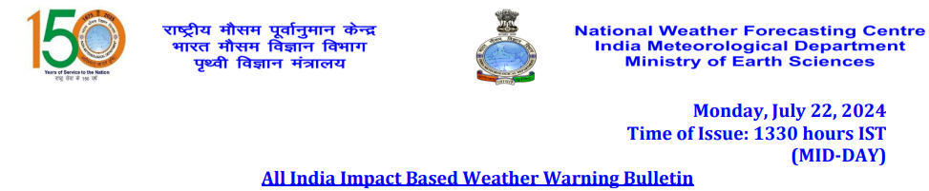
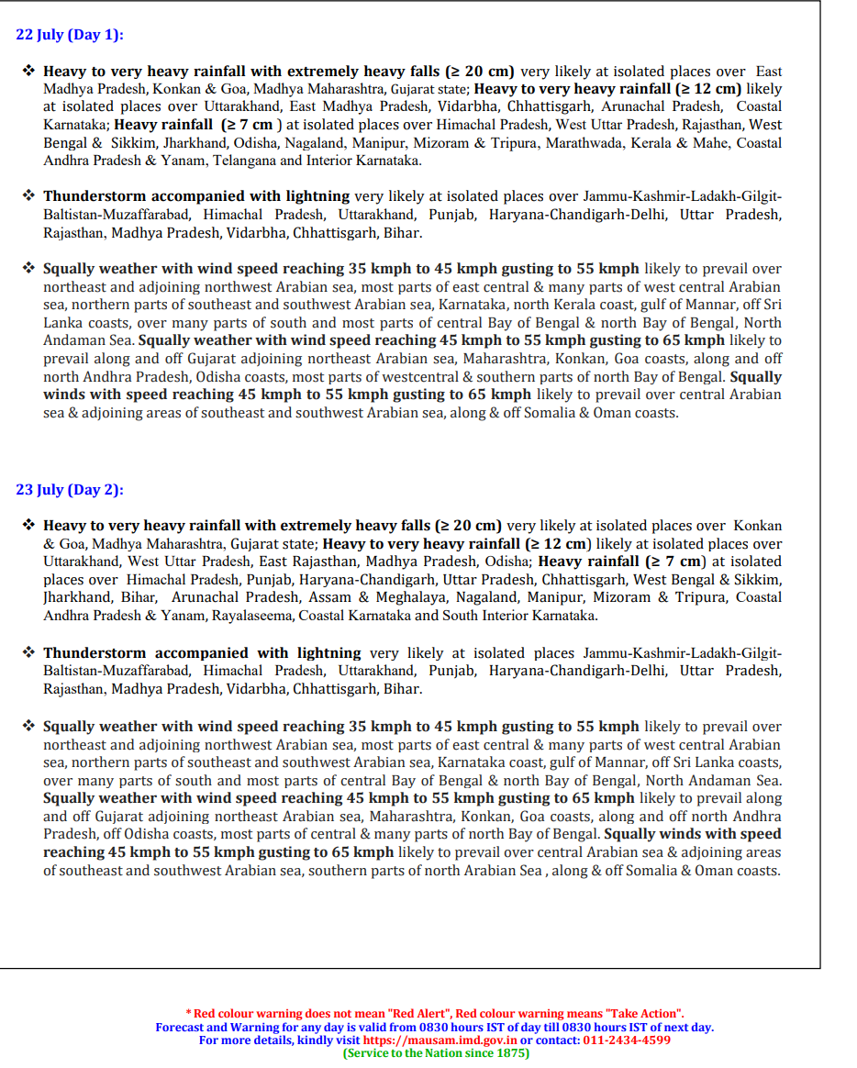
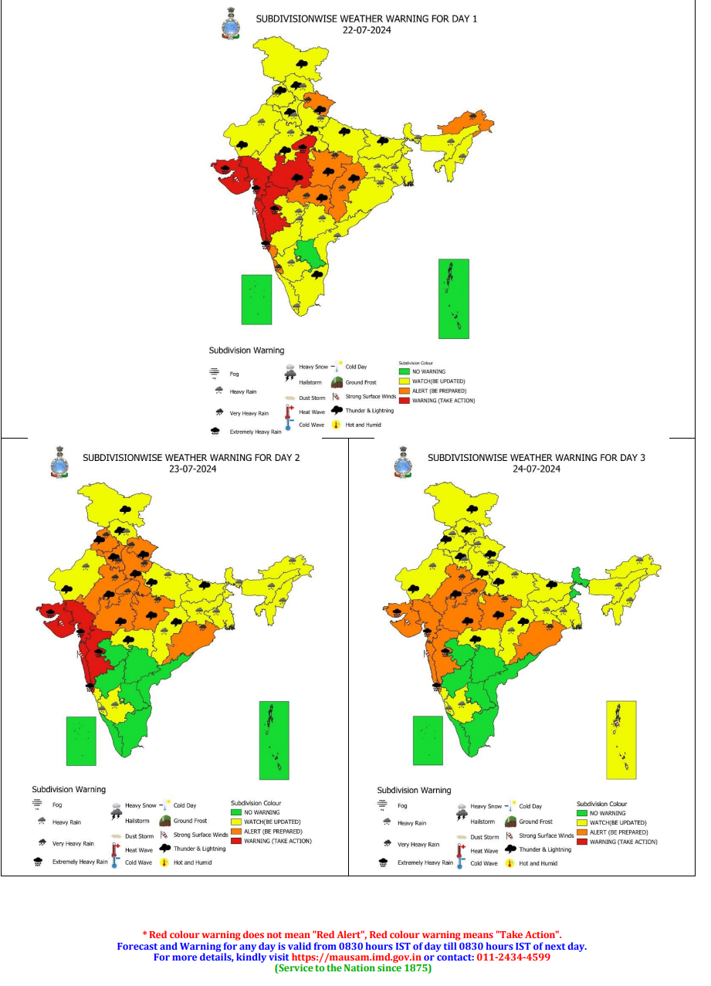
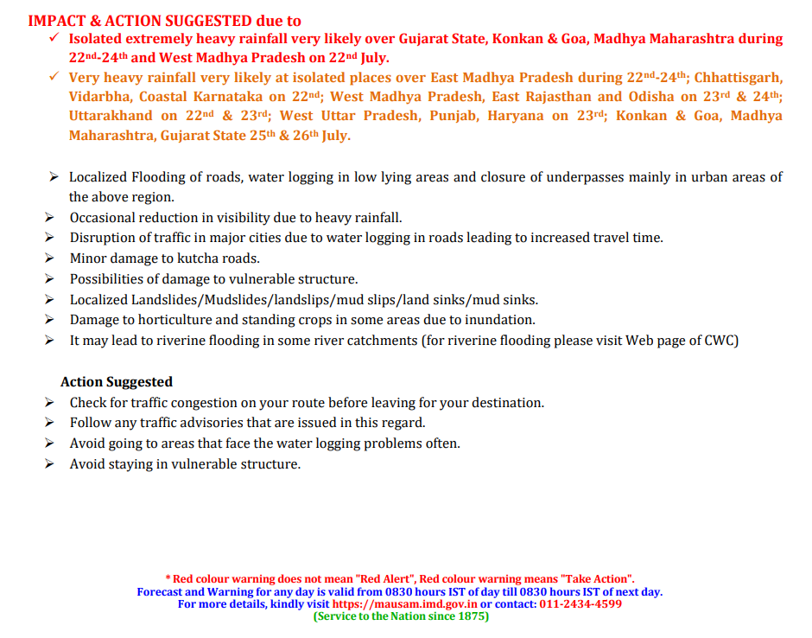
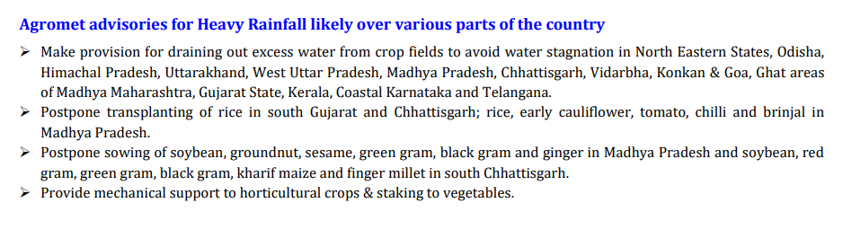
All India Impact Based Weather Warning Bulletin

Slide 22
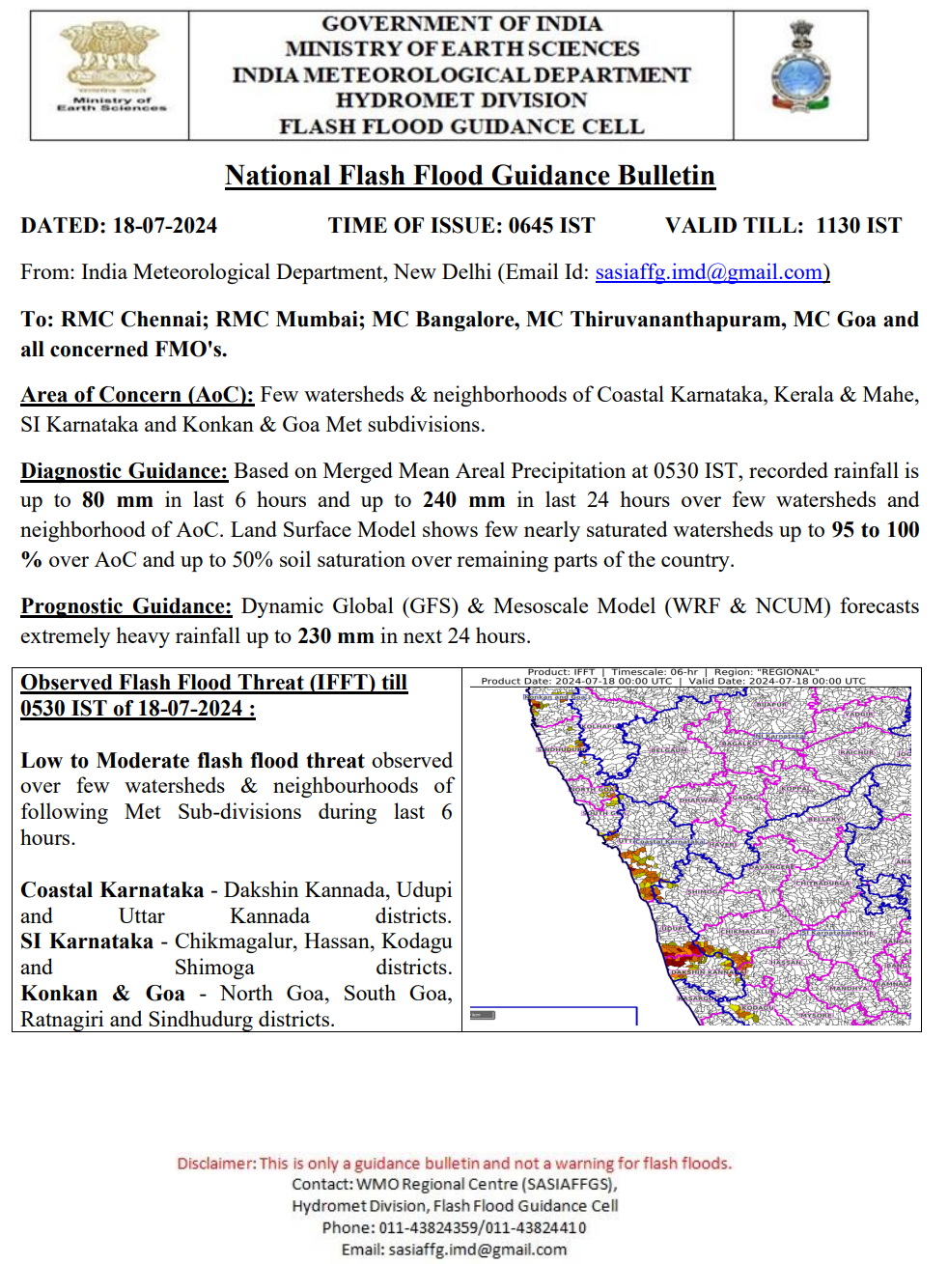
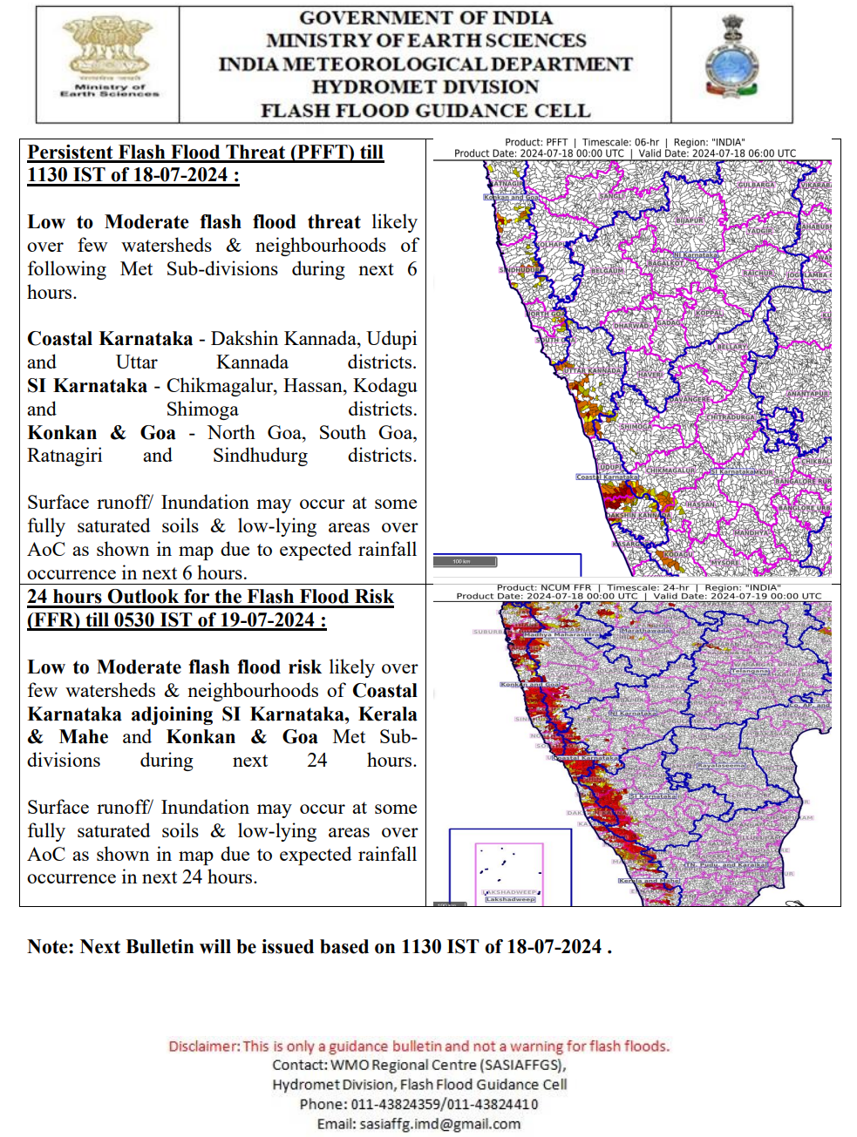
Flash Flood Guidance

Slide 23
Gramin Krishi Mausam Sewa (Agrometeorological Advisory Services)
GKMS Background
Objective
Agromet advisory services
Network
Source of Observations
Agromet products
R&D collaborations
Block level forecast & advisory dissemination for Karnataka

Slide 24
GKMS
Growing uncertainties of weather and climate pose a major threat to food productivity and security of the country and thus, warrant for farmers’ empowerment of informed decisions in agricultural risk management.
However, adverse effects on crops can often be mitigated.
Risk in agricultural operations can be minimized by the provision of weather information properly interpreted for their agricultural significance, containing advisories for farm operations, and disseminated well in advance of the impending weather.
IMD, MoES in collaboration with ICAR and SAUs and other institutions is rendering weather forecast based District/Block level Agrometeorological Advisory Services (AAS) for the benefits of farmers in the country under the scheme “Gramin Krishi Mausam Sewa (GKMS)”

Slide 25
Objectives of GKMS
To continuously improve the existing District level Agromet Advisory Services (AAS) and extend them further to Block level.
To establish District Agro-Met Units (DAMUs) in close cooperation with ICAR at Krishi Vigyan Kendra’s (KVKs).
To expand the existing channels of communication of weather based agro-met advisories to the farmers so as to expand the outreach to cover all farmer households in the country.
Promote Research & Excellence in Agro-meteorology in support of targeted improvement to the operational services.

Slide 26
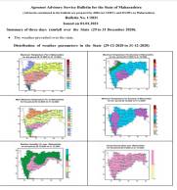
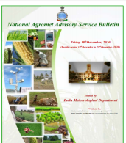
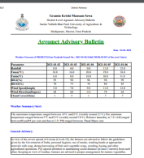
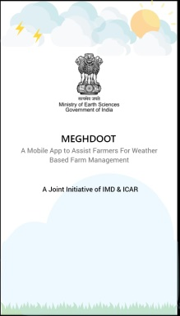

Agrometeorological Advisory Services (AAS) to Farmers
Weather Forecast
Model
Forecast
Rainfall, Temperature,
Wind, Humidity,
Cloud cover
Composite State Level Bulletin
Medium range Weather Forecast
State Met Centre
Stakeholders’ Awareness
Composite National Bulletin
Value added forecast at district / Block level for 5 days
Biweekly (Tuesday & Friday) Weather based Farm Advisory for all districts and ~3100 blocks in English & Regional languages
Agromet Field Units/
District Agromet Units
Special Weather Advisory during extreme events
Multi-Channel Dissemination
Radio, TV, Press, KVKs, State Extension mechanism, Public-Private Partners (IKSL & Reliance Foundation), Mobile text message, Mobile Apps, Social media
Farmer Awareness Program (FAP)
Training programmes
Dynamic & End of Season Feedback mechanism
Economic benefits from savings in farm inputs.
Increased farm productivity and food security.

Slide 27
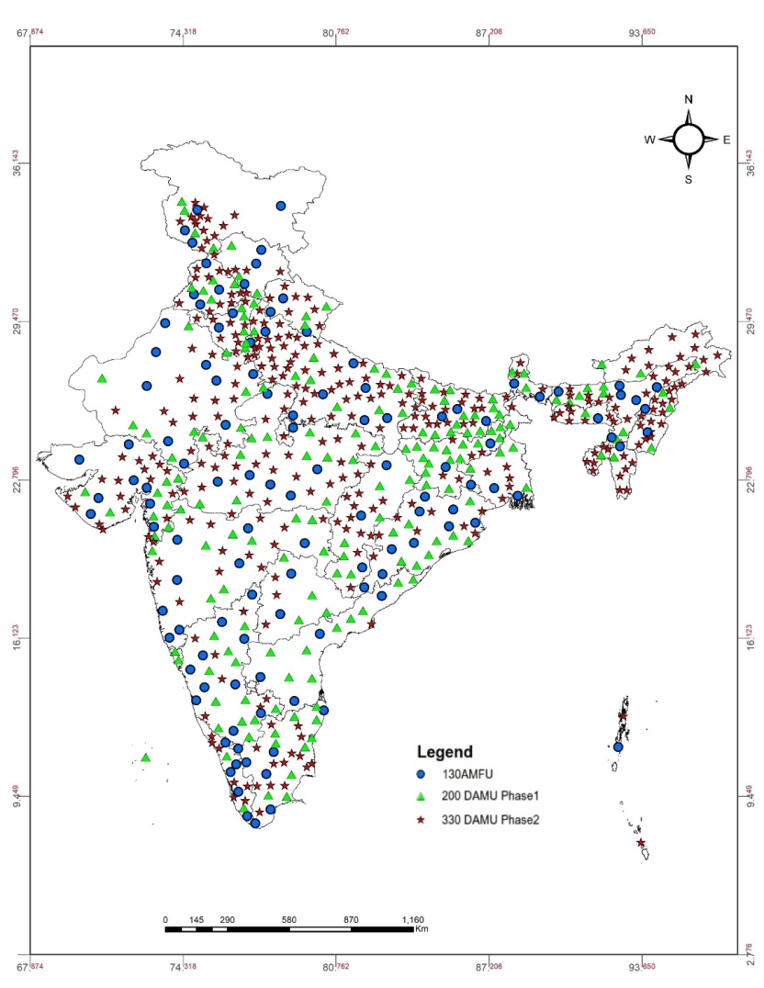
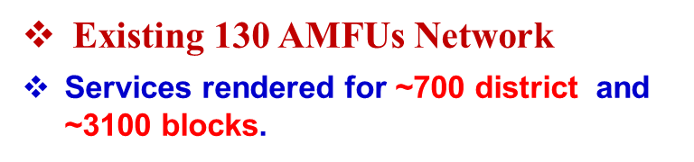
GKMS network

Slide 28
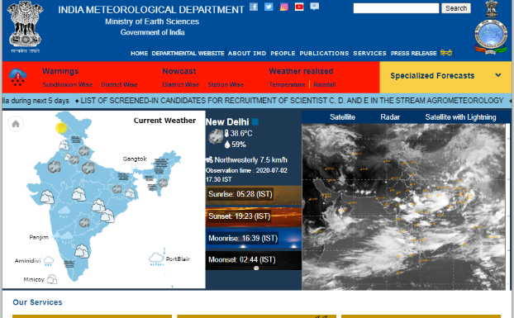
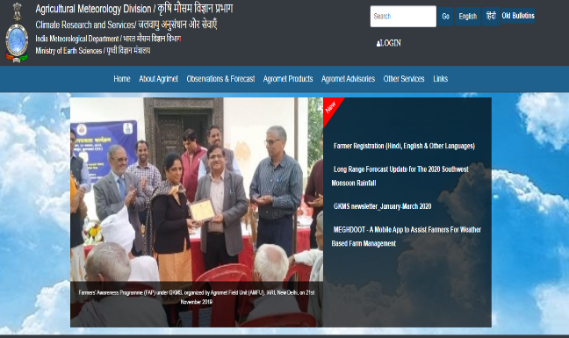
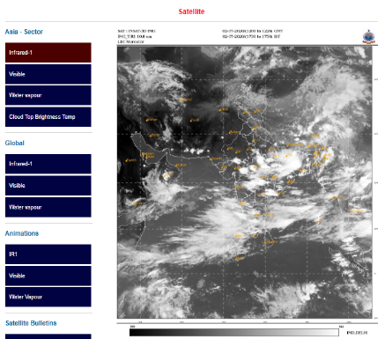
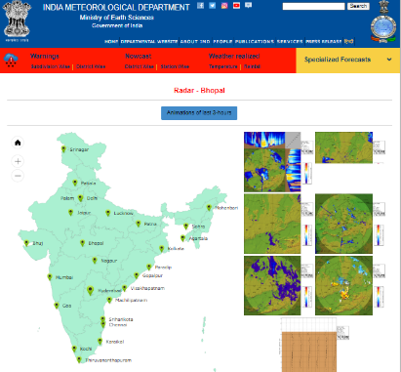
Source of Observation
Weather Observation from established observatory of IMD
State observatory network data (If available)
Long term weather data to compute normal and probability of extreme climatic events
Soil moisture observation using Augur method
Crop, P&D related data from State agencies
AWS at DAMUs
IMD Website
https://mausam.imd.gov.in/
Agromet Product
http://imdagrimet.gov.in/imdproject/AGIndex.php
Satellite Information
https://mausam.imd.gov.in/imd_latest/contents/satellite.php
RADAR information
https://mausam.imd.gov.in/imd_latest/contents/index_radar.php

Slide 29
Weather Forecast spectrum for Agriculture
  Nowcast for 3 hours (Location specific)
  Medium Range up to 10 days (Block/City/District/ Met Subdiv.) with probability
  Extended range for 4 weeks (Met Sub-div. / State / Homogeneous regions)
  Long range for season (Homogeneous regions / country)
  Early warning system on extreme events: Cyclone / Hailstorm / Thunderstorm / Cold & Heat wave / Drought.

Slide 30
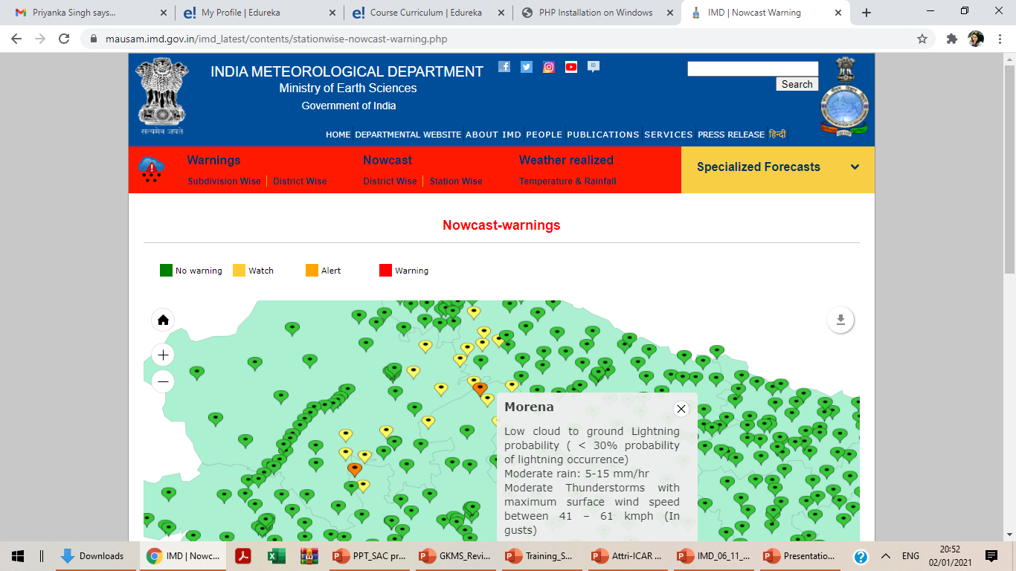
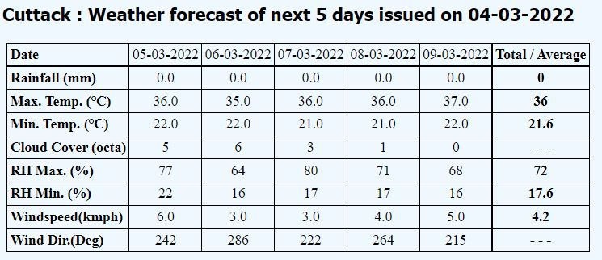
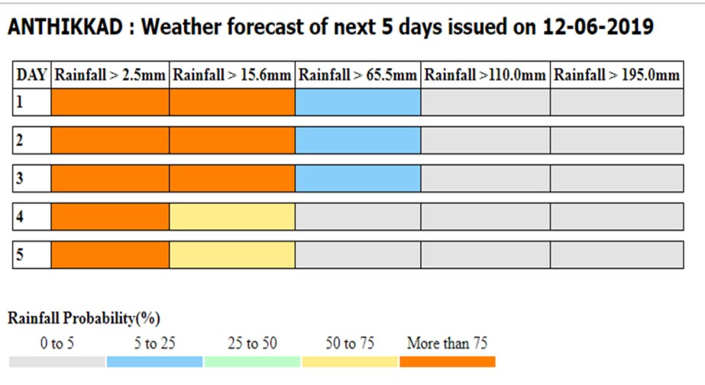
Nowcast
Thunderstorm, Hailstorm
Squall
Medium range Forecast
NWP model: T-1534
Res: 12.5 km
Probabilistic block level
medium range forecast

Slide 31
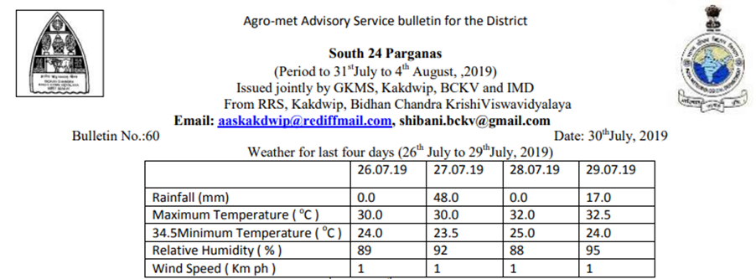
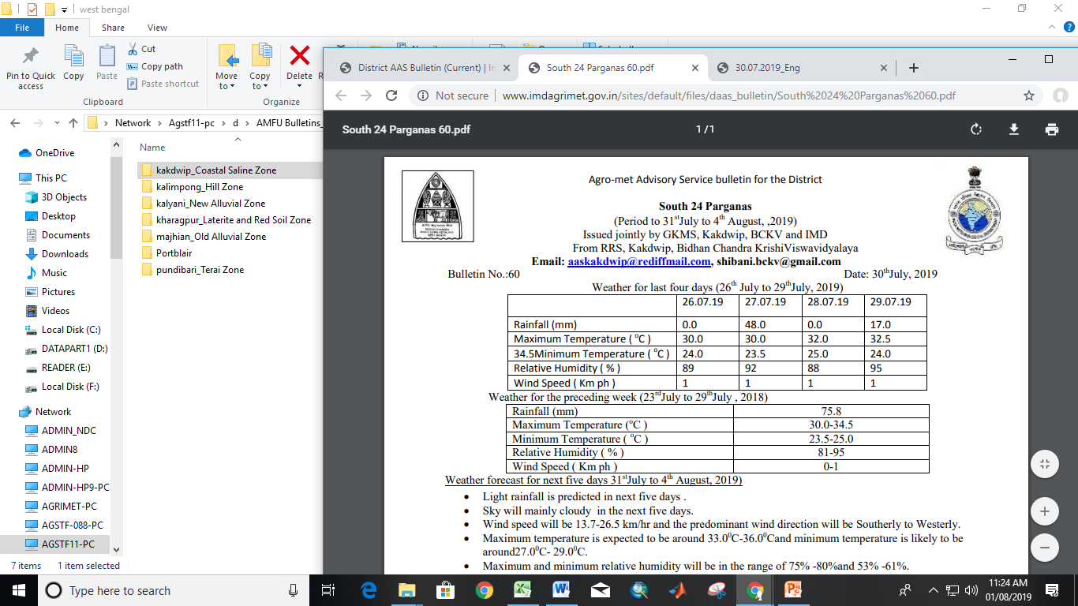
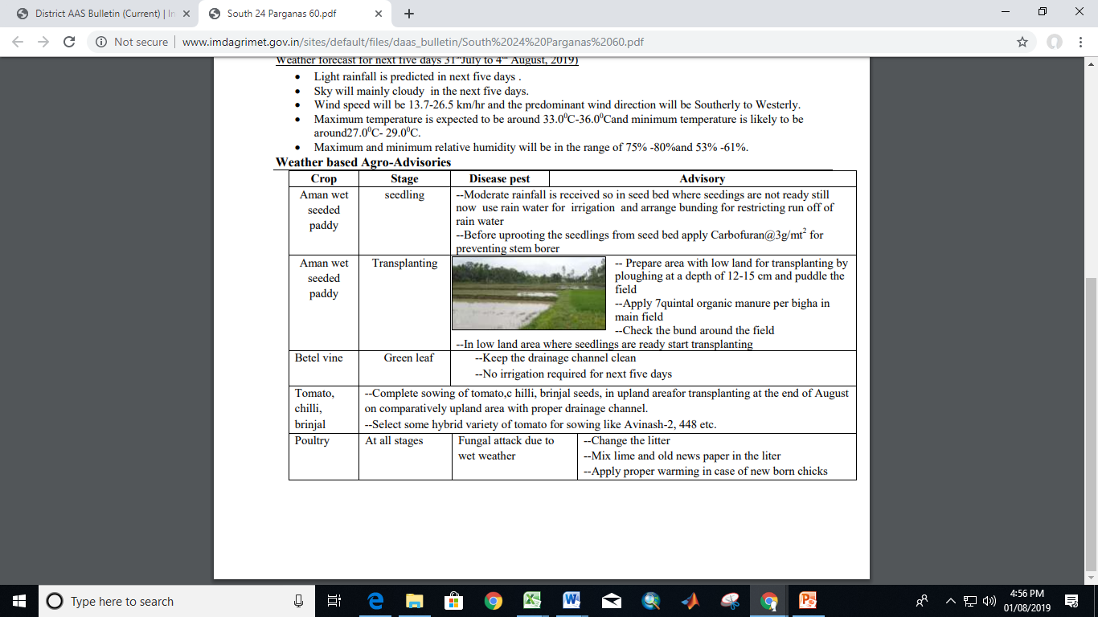
Inputs for Preparation of Agromet Advisories
Sensitivity of Crop to weather
Past Weather
Quantitative medium range
weather Forecast for next Five days
Crop stage & state and advisories
Diagnose weather related stresses
Moisture, weather based pest & disease occurrence, excessive Heating & dessication, cold injury and frost, soil born biotic stress, soil health & nutrient related issues, extreme weather related issues.
AND ADVISE MITIGATION
Location wise Contingency action

Slide 32
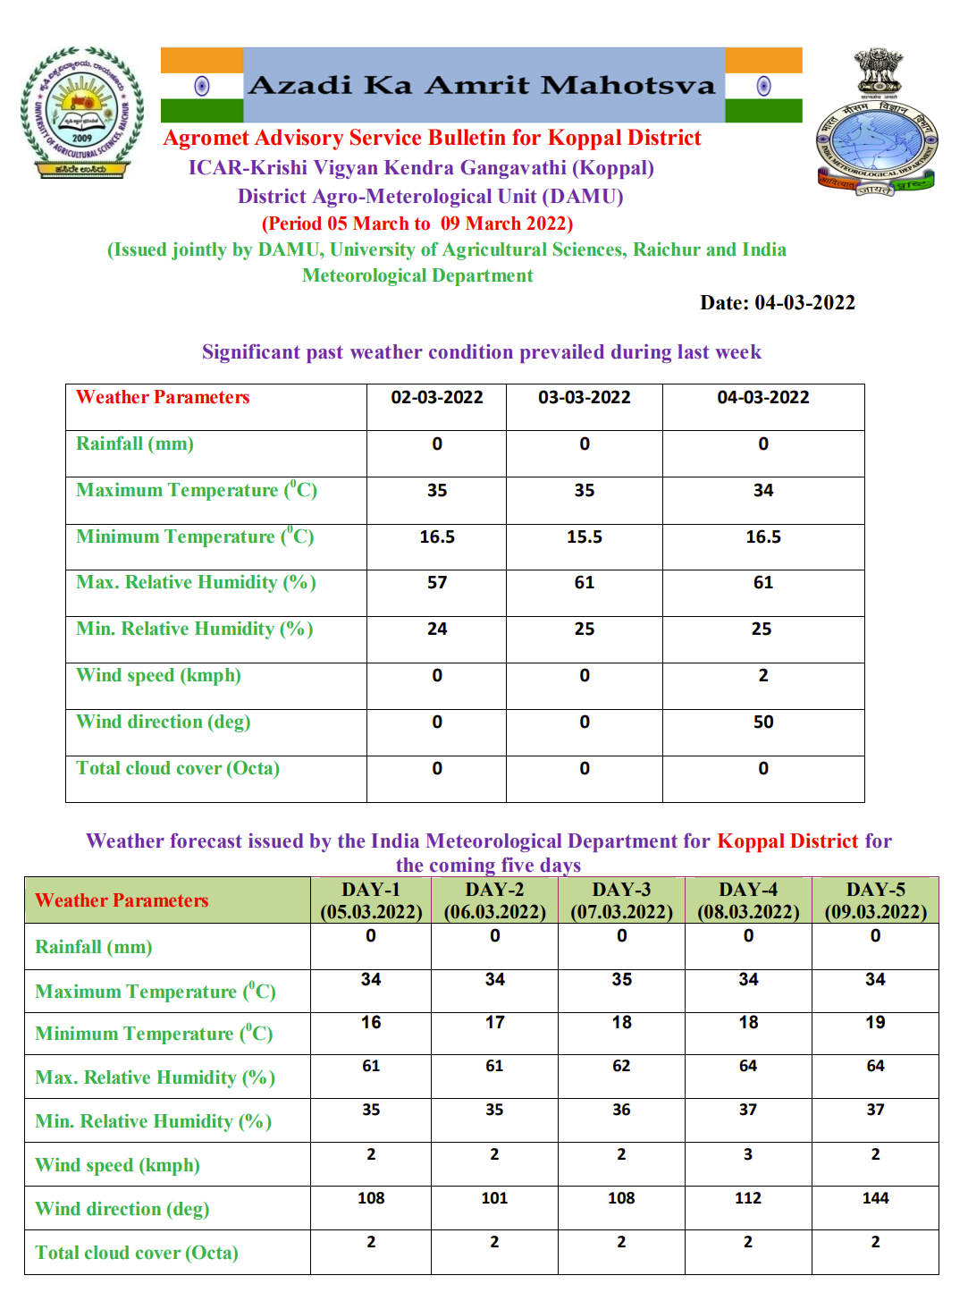
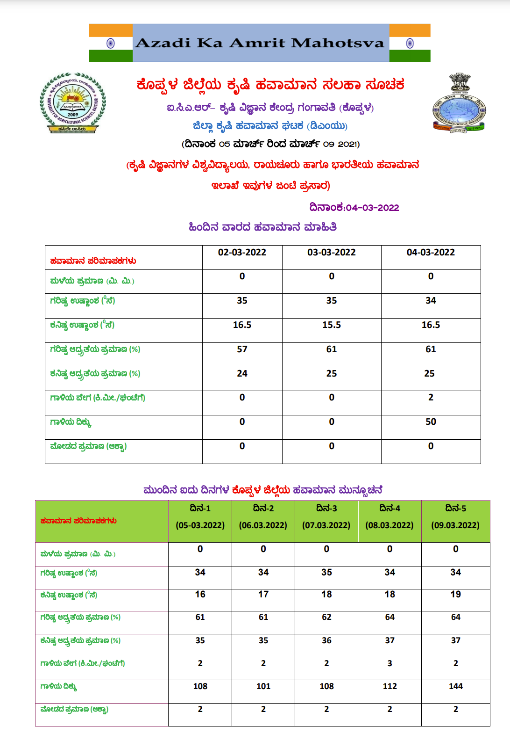
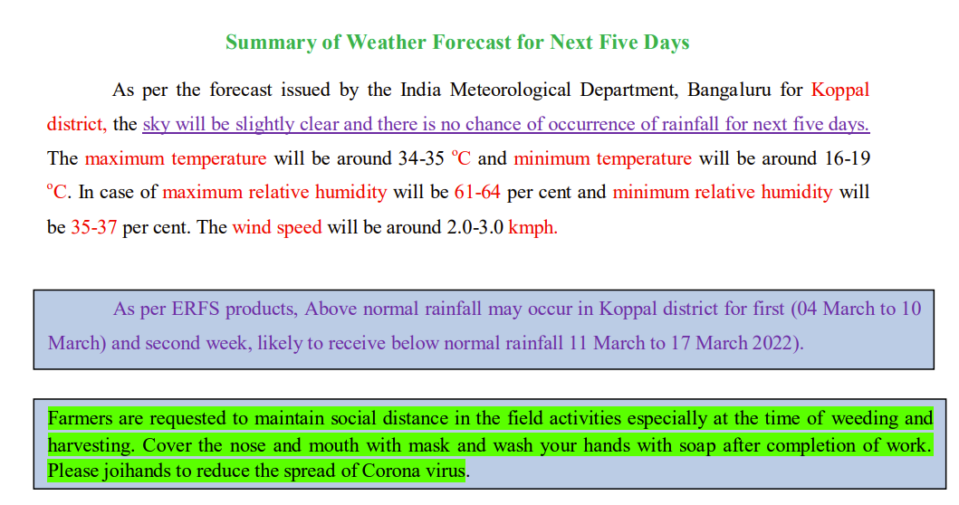
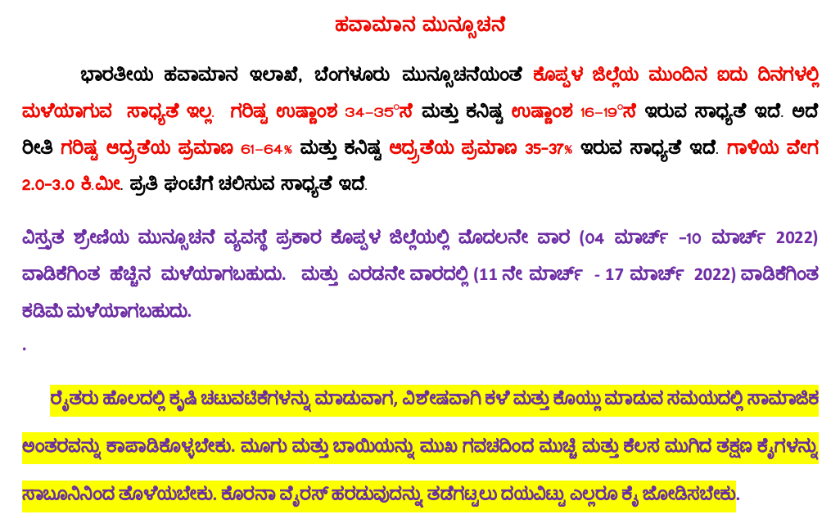
Agromet Bulletin-Sample

Slide 33





AAS Bulletin
National Level Bulletin
State Level Bulletin
District & Block Level Bulletin

Slide 34


National Agromet Advisory Service Bulletin based on Extended range weather forecast (ERF)

Slide 35




Agromet Decision Support System (http:agromet.imd.gov.in)
System Overview
Modules available in Agromet-DSS

Slide 36
Agromet Products
In Use
Spatial distribution of weather parameters (Daily, Weekly, Fortnightly, Monthly, Seasonal)
Soil Moisture maps
Crop weather calendar
Pest weather calendar
Weekly products:
SPI & SPEI, both realized and forecasted
Normalized Differential vegetation Index
Vegetation Condition Index
Temperature Condition Index
Vegetation Health Index
In pilot mode
Reference evapotranspiration (daily)
Insolation on daily scale
Evaporation ( Daily, Weekly)
Soil Temperatures at different depths (Daily, Weekly)

Slide 37

Development of Forewarning model for
Pest and Disease
Based on
Min & Max Temperature ,
Relative humidity, Rainfall, Cloud , Soil moisture, Wind Speed,
Forewarning models.
& Pest weather calendars prepared by using these parameters, act as reference tool for agromet advisory.

Slide 38
Dissemination of AAS

Slide 39
Dissemination of AAS
SMS advisories in regional languages are sent through mKisan portal of MOAg (currently SMS are sent for extreme weather events only).
MOAg is developing platform where farmers can pull the information.
Mobile App: Meghdoot, Umang, Kisan Mitra, Kisan Suvidha, Damini (for nowcast)
Website:
IMD-Agrimet, State Agriculture University , KVK of ICAR, IIT, MSSRF, eNAM
Mass media:
DD KISAN, Regional DD centers, Private TV Channels
Newspaper and All India Radio (AIR)
PPP Mode: Kisan Sanchar, Reliance Foundation, NGOs
Dissemination through WhatsApp Presently 11,89,000 farmers in 1,10,820 villages are receiving advisories directly through 14845 WhatsApp groups.
Extension system of State Agriculture Department:
Integration of weather forecast and advisory with the Apps/ Web services
Disseminated through Rural Ag. Extension officers at village level

Slide 40
Integration with State Govt. Mobile App/Web Services
State | No. of farmers covered (In Lakhs)
Madhya Pradesh | 10
Tamil Nadu | 10
Gujarat | 36
Nagaland | 0.79
Chhattisgarh | 2
Haryana | 3.6
*Integration is in process for remaining states

Slide 41

Dissemination through Website
http://imdagrimet.gov.in/imdproject/AGIndex.php
Purpose – To assemble and cater all the Agriculture Meteorology related information at single domain

Slide 42







Dissemination through Mobile Apps

Slide 43
Dissemination through WhatsApp
No. of WhatsApp Gr. & Block covered
No. of Farmers & Villages covered

Slide 44
Extension System Of SAD for dissemination
State Department of Agriculture
Social media: Whatsapp
DAOs
SAD: State Agriculture Department
DAO: District Agriculture Officer
BAO: Block Agriculture Officer
RAEO: Rural Agriculture Extension Officer Department
BAOs
RAEOs
Farmers

Slide 45




Farmers Awareness Programme
1384 FAPs have been organized during the 2020-21
1432 FAPs have been organized since 2021-22.
AMFUs/DAMUs also arranged field visits, field demonstration, farmers’ interaction and also participated in Kisan Mela
Popularizations of Meghdoot App
GKMS services also demonstrated in FAP organized under other programmes of KVK
DAMU-Hagari, Ballari
DAMU-Gangavathi
DAMU-Haveri

Slide 46




Feedback on AAS
  Dynamic real-time
  Weekly/fortnightly feedback from farmers on weather forecast and crop advisory (to be made App based in future) and their analysis initiated by ~165 DAMUs and ~55 AMFUs
  End of season report using questionnaire survey
  Farmers feedback is collected at national level using Google platform through TO / SMS. 2614 feedback received at the end of Kharif 2020.
Farmers experience
88 success stories uploaded on Agrimet Pune dashboard since Apr 2021
Since Oct 2020, 226 videos on farmer’s feedback uploaded on YouTube channel of AAS-https://www.youtube.com/channel/UCjIcIwtznloxlqa0Xh4j5qQ/videos
(*Response received for more than one source option also

Slide 47
R& D
New Initiative

Slide 48

Dynamic Crop Weather Calendar(DCWC) in Collaboration with ICAR-CRIDA
Validated at 31 locations.
Predicated sowing dates using soil water balance showed good agreement between predicted and observed dates.
Handing over DCWC to DAMU KVKs to run DCWC at their centres.
Collation of weather and crop experimental data from Units.
Inclusion of more features in the DCWC based on feedback from DAMUs.
Variable sowing window
Duration of varieties
Incorporation of weather forecast
Estimation of sowing date based on soil water balance/ cumulative rainfall or both
Prediction of phenology
Estimation of stage wise crop water requirement
Probability of dry /wet spells/extreme rainfall events
Linking with contingency plans (CRIDA)
Linking with pest and disease models

Slide 49
Experimental Monthly and Seasonal forecast at State level
Forecast From GCM/AOGCM
Methodology
Evaluation & Bias Correction
Multi-Model Ensemble
Deterministic
1.Simple Mean (MME1)
2.Superensemble(MME2)
3.Supervised PCR (Sup-PCR)
4.Canonical Correlation Analysis (CCA)
Combined Forecast
Probabilistic
Validation in Hindcast
Final Forecast
Notes:
49

Slide 50
thanks

